Slide 1

Stage 1 An L By Any Other Name Course Designer: Marcel Englmaier
An L By Any Other Name is a 21 round, 105 point Comstock Long course. There are 9 USPSA targets and 3 steel targets. The best two hits per target will score. Steel must fall to score. The start signal is audible.
The Handgun start position is standing with toes touching Xs and wrists below belt. Handgun is loaded and holstered The PCC start position is standing with toes touching Xs and PCC loaded with stock touching belt and muzzle pointed downrange.
On the audible start signal, engage targets from within the shooting area.

Slide 2
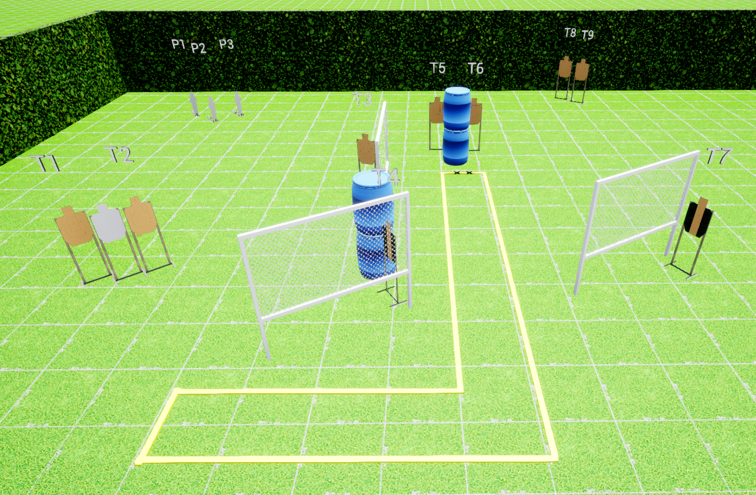
 | Stage 1 An L By Any Other Name Course Designer: Marcel Englmaier

